Slide 1

BODY MASS INDEX

Slide 2

Body Mass Index (BMI) is a measure of body fat based on height and weight that applies to adult men and women. This application create to help other people to know their ideal weight on their age now, and give a different tips based on status in BMI Calculator .

Slide 3
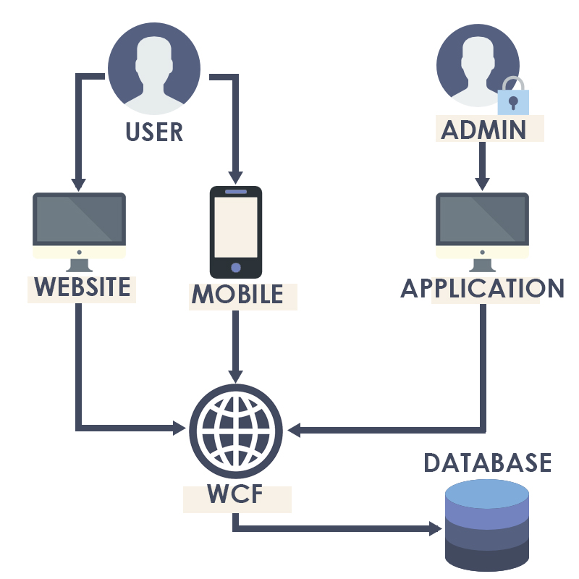

Slide 4



Mobile App
Java
Desktop App
C#
WEBSITE
PHP

Slide 5
Lets run the app

Slide 6
Thank you

